Slide 1


JMB/JDA Real estate WEBINAR
“Recovering Together: 2021 & Beyond”
CONSTRUCTION FINANCING OPTIONS
Presented By Mr. Courtney Wynter
January 28, 2021

Slide 2
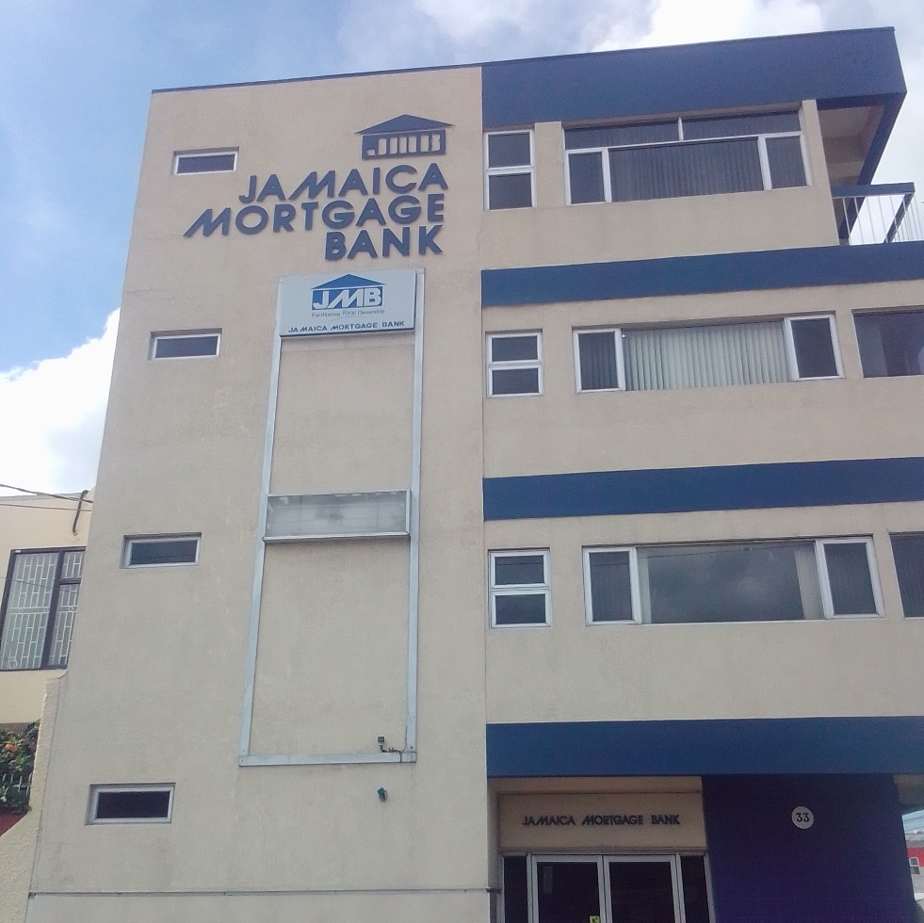
JMB’s History
Mandate
Performance Data (5 Yrs)
Financing Options

Slide 3
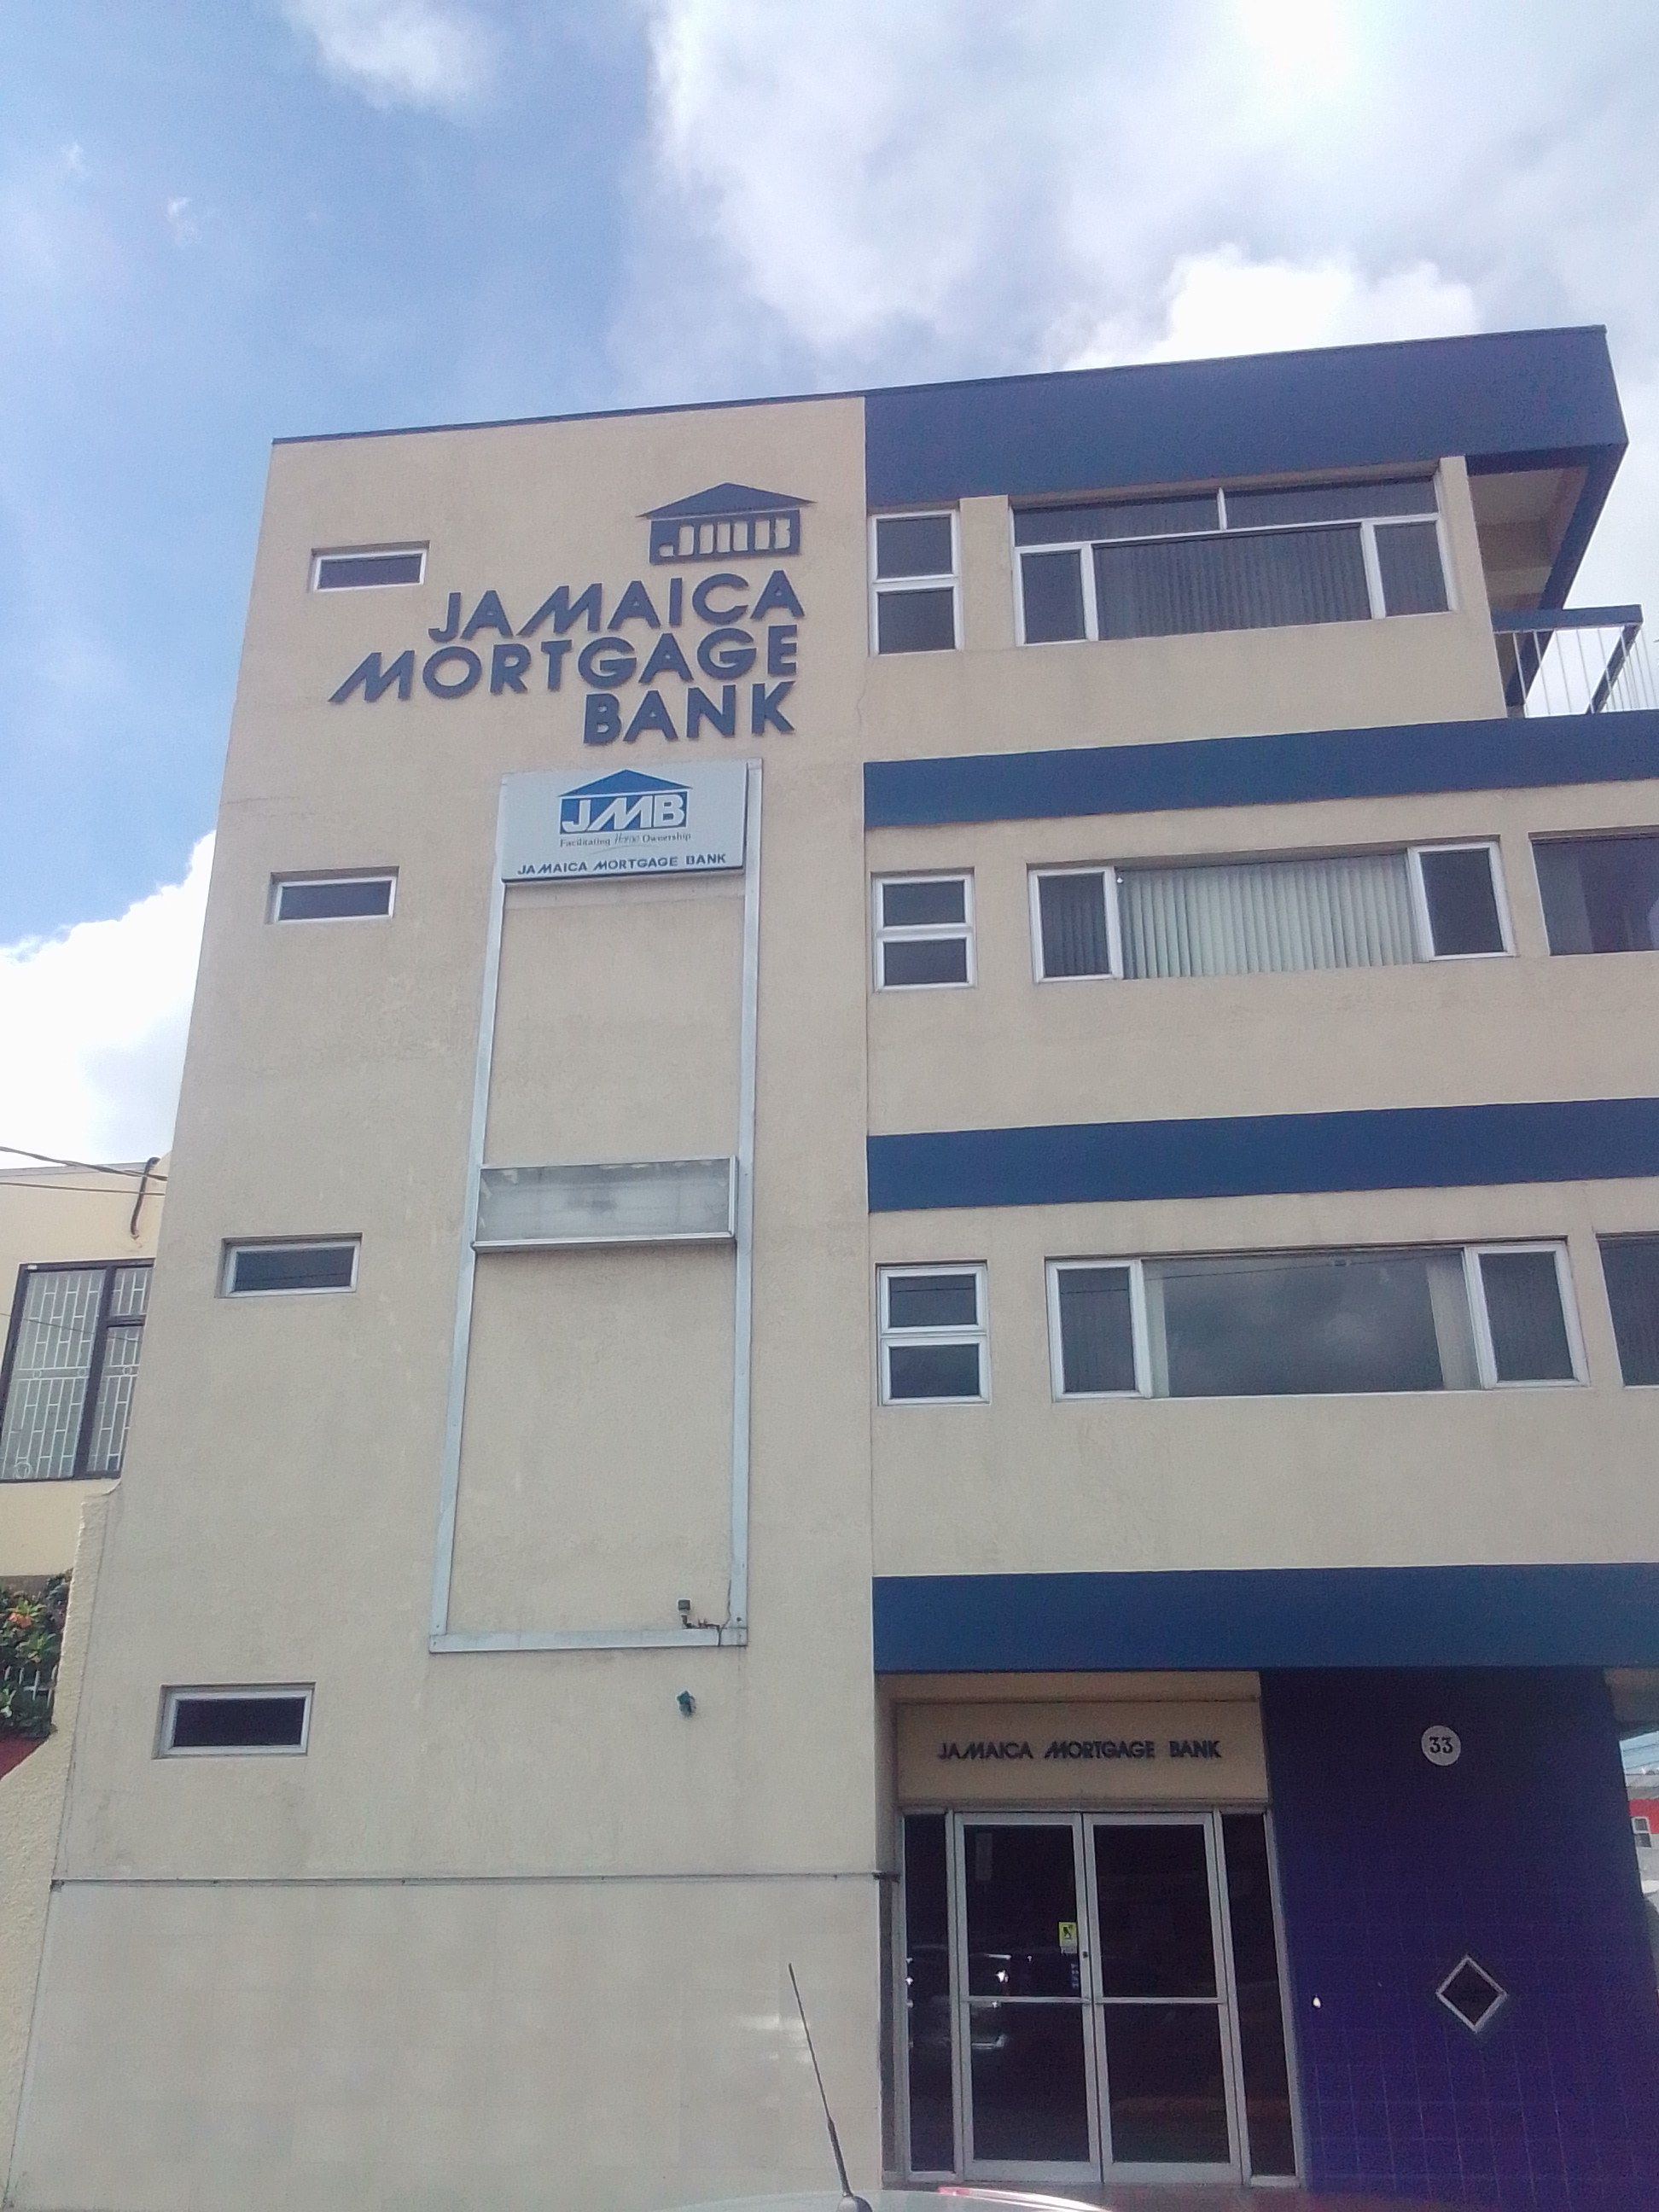
BRIEF HISTORY
The Bank was established on June 2, 1971 as a private liability company
On June 5, 1973, an act of Parliament converted the Bank to a statutory corporation.

Slide 4
BRIEF HISTORY CONT’D.
In the mid 80s and early 90s, The Jamaica Mortgage Bank (JMB) partnered with the Caribbean Housing Corporation (CHC) to fund housing solutions across Jamaica, especially during the build out of Portmore, including issuance of retail mortgages linked with MII.
The operation of the CHC was subsequently subsumed under the National Housing Development Corporation, which we now know as the Housing Agency of Jamaica (HAJ).

Slide 5
VISION STATEMENT
JMB’s Vision:
To finance safe and affordable housing so that all Jamaicans will have access to home ownership

Slide 6
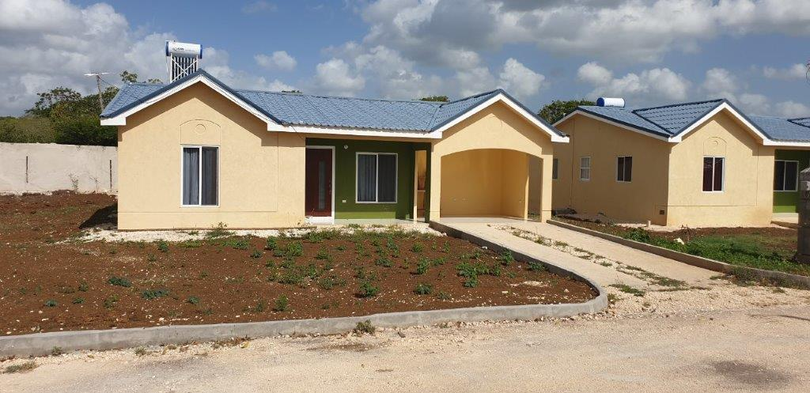
JMB’s MANDATE
Nell’s Cottage, Clarendon
To Finance safe and affordable housing so that all Jamaicans will have access to home ownership.
  Provide Financing in the Primary Market
  Provide Financing in the Secondary Market
  Manage the Government of Jamaica’s Mortgage Insurance Plan

Slide 7
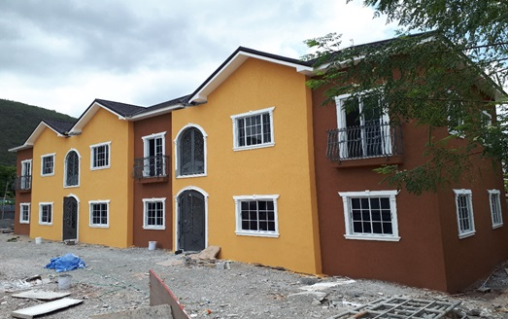
PRIMARY MARKET PERFORMANCE
Island-wide
Beaconfield, St. Andrew

Slide 8




Slide 9

Mission Statement
To be a profitable organization mobilizing financial resources for on-lending to public and private sector developers and financial institutions, developing an active secondary mortgage market and providing mortgage indemnity insurance in support of the national settlement goal.

Slide 10
Vision Statement
To finance safe and affordable housing so that all Jamaicans will have access to home ownership.

Slide 11
JMB Facilitating Home Ownership in the
1970s

Slide 12

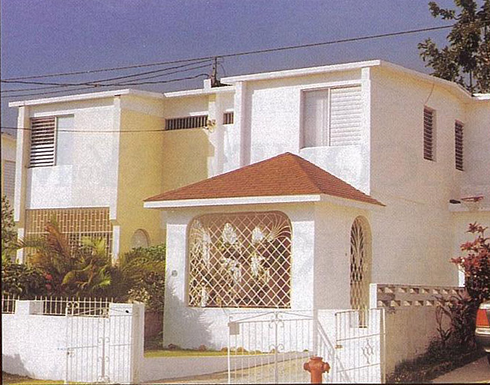
Blue Castle
St. Andrew
“Home is the place your heart resides”
-Aisha Patterson

Slide 13
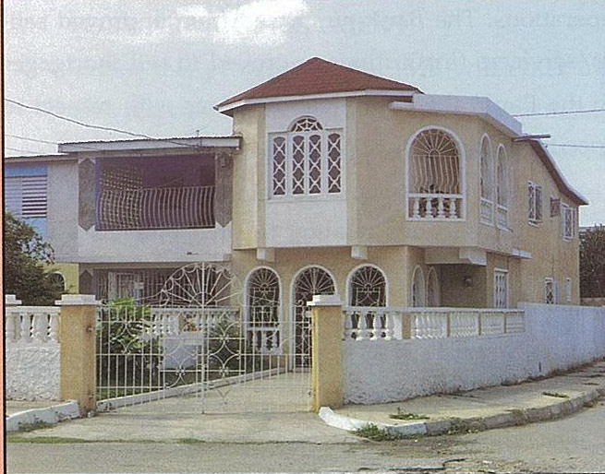
Cooreville Gardens
St. Andrew
Another good housing scheme for Jamaicans

Slide 14
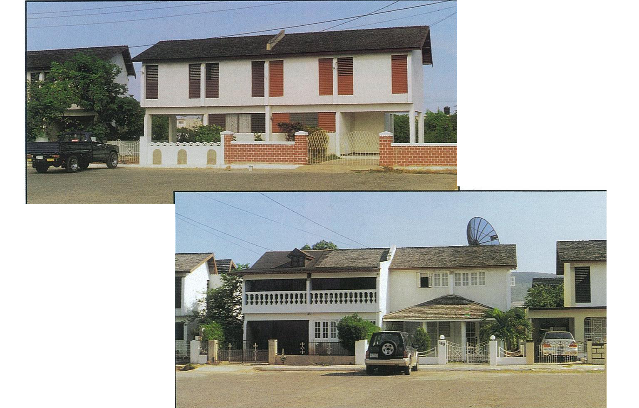
Garveymead
St. Catherine
“Home is the womb that holds the soul”
Aisha Patterson

Slide 15
Garveymead
St. Catherine
“Home is the womb that holds the soul”
Aisha Patterson

Slide 16
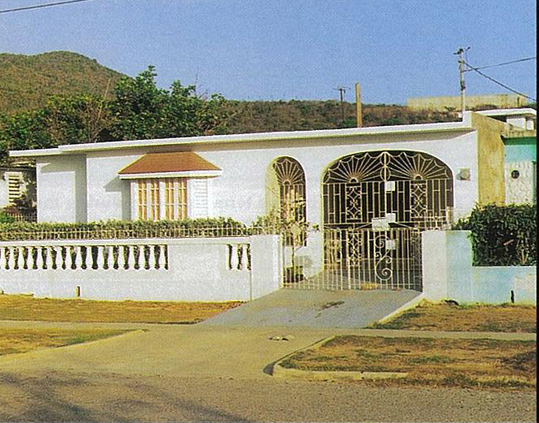
Braeton
St. Catherine
“No more from that cottage again will I roam;
Be it ever so humble, there's no place like home.” - John Howard Payne

Slide 17
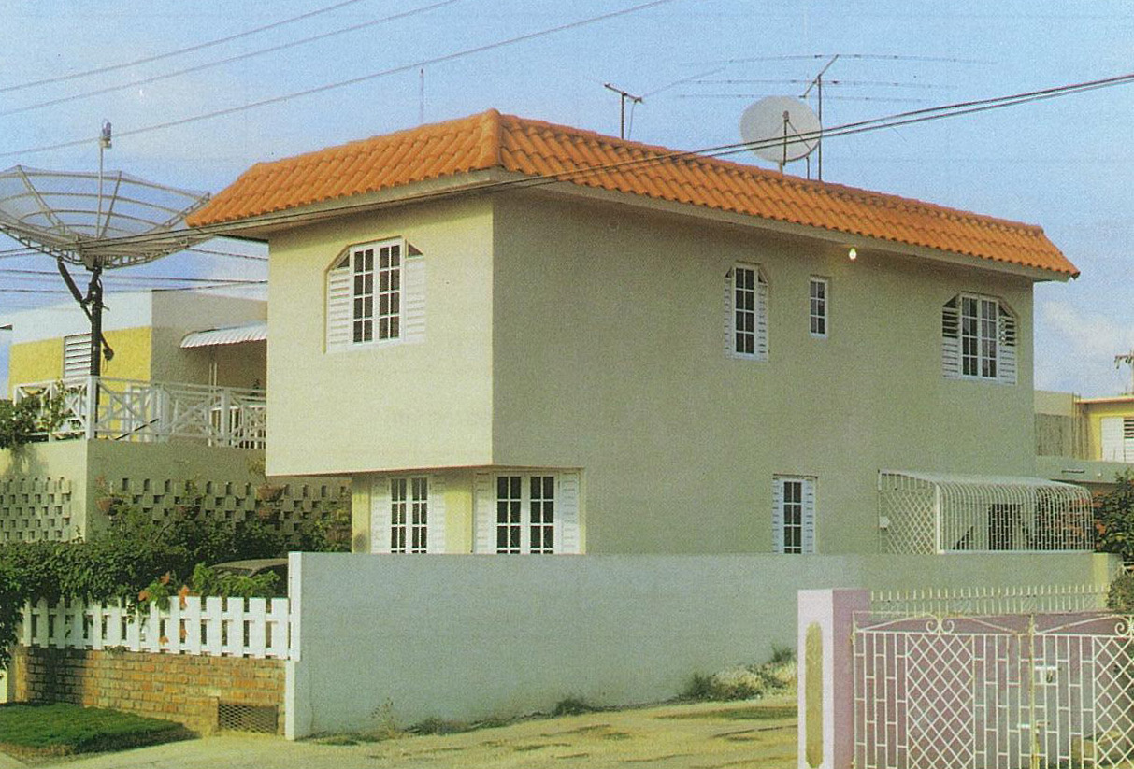
Marine Park
St. Catherine
“Home is the place your heart resides”
-Aisha Patterson

Slide 18
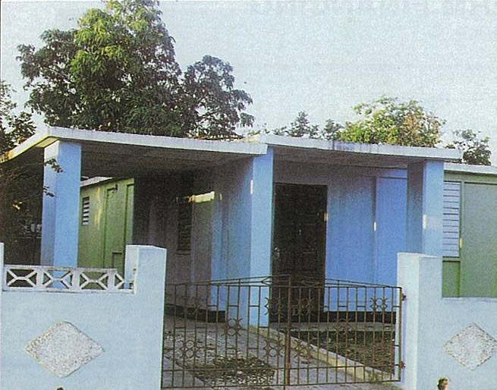
Passage Fort
St. Catherine
“Home is the womb that holds the soul”
Aisha Patterson

Slide 19
JMB Facilitating Home Ownership in the
1980s

Slide 20
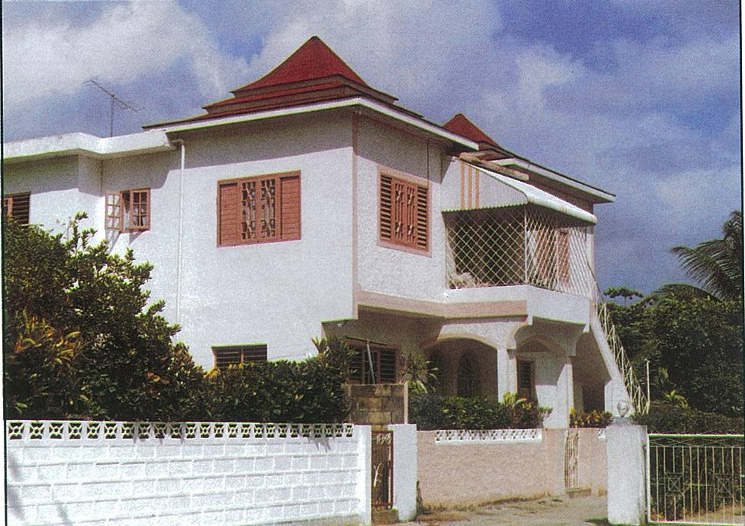

Catherine Hall
St. James
“No more from that cottage again will I roam;
Be it ever so humble, there's no place like home.” - John Howard Payne

Slide 21
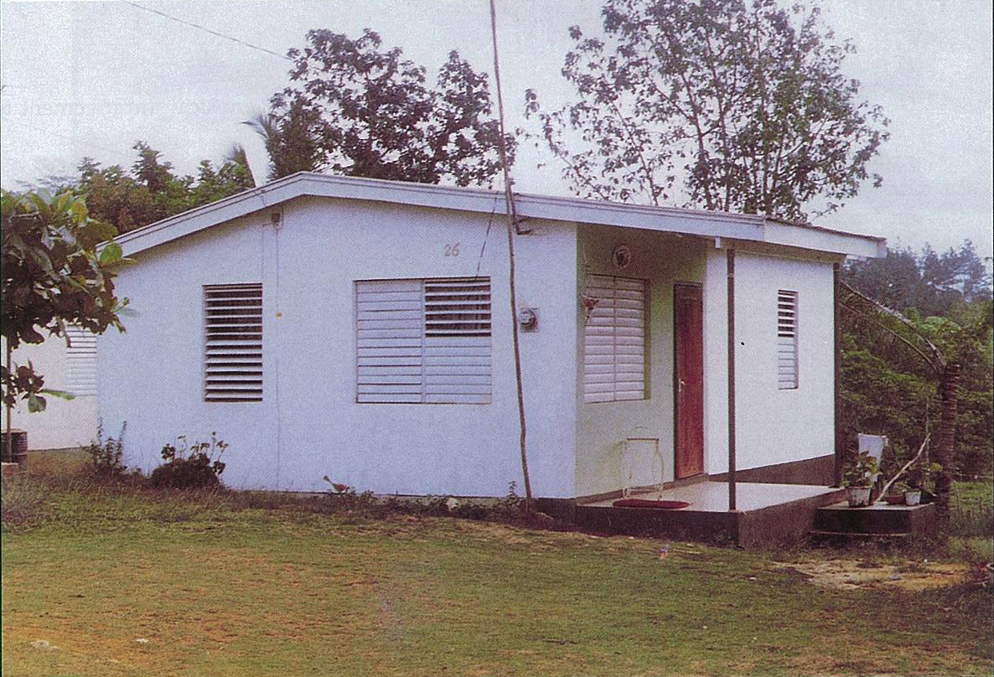
Moneague
St. Ann
“Home is the womb that holds the soul”
Aisha Patterson

Slide 22
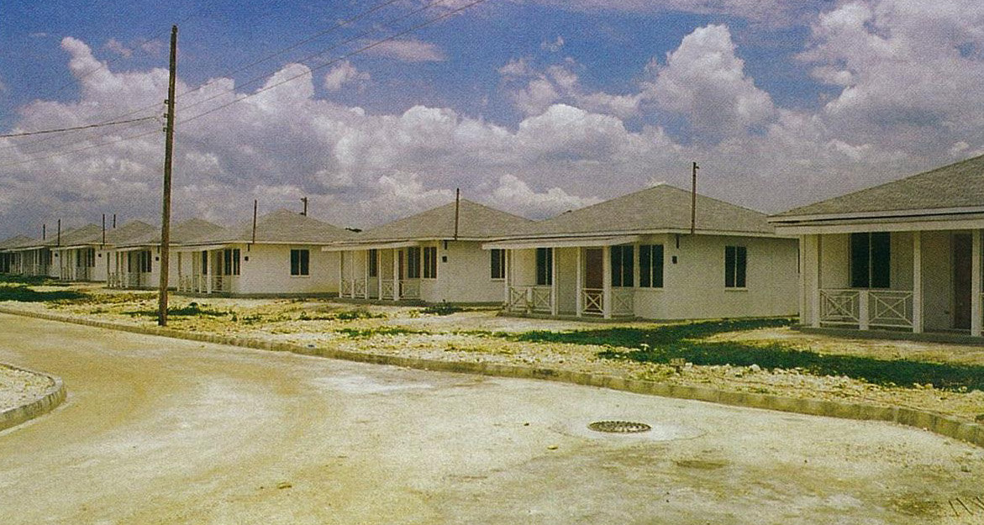
Llandilo
Westmoreland
“Pleasures and palaces though we may roam,
Be it ever so humble, there's no place like home” -John Howard Payne

Slide 23
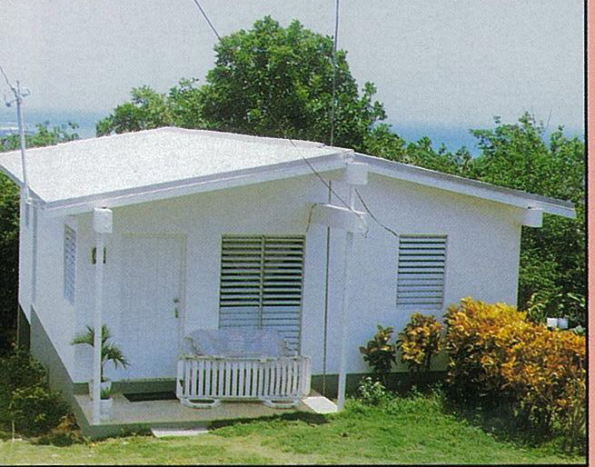
Hague
Trelawny
“Home is the place your heart resides”
-Aisha Patterson

Slide 24
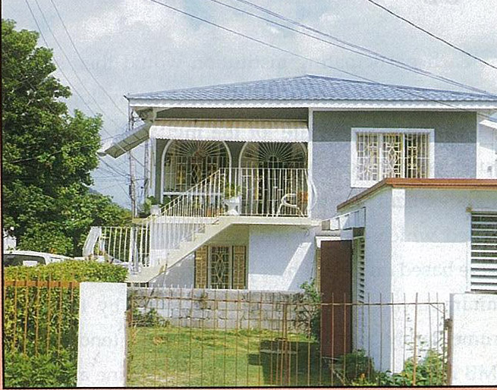
Mansfield Park
St. Ann (Ocho Rios)
"But give me, oh, give me, the pleasures of home.”
John Howard Payne

Slide 25
JMB Facilitating Home Ownership in the
1990s

Slide 26
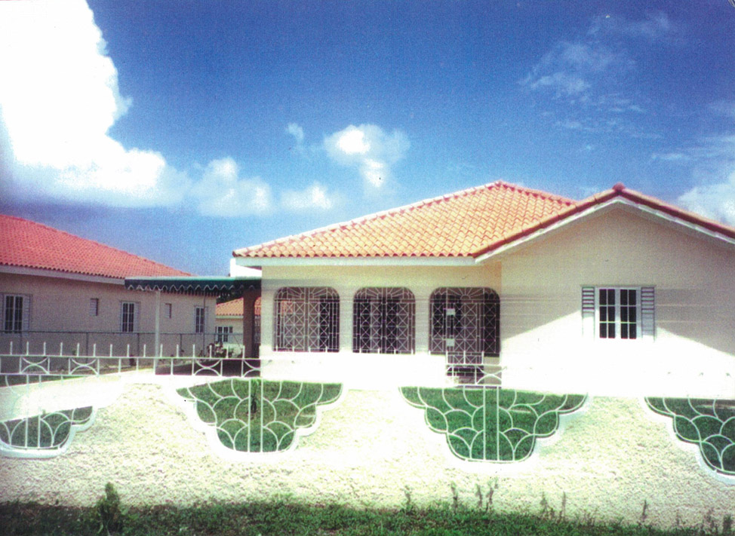

Rio Nuevo
St. Mary
“Pleasures and palaces though we may roam,
Be it ever so humble, there's no place like home” -John Howard Payne

Slide 27
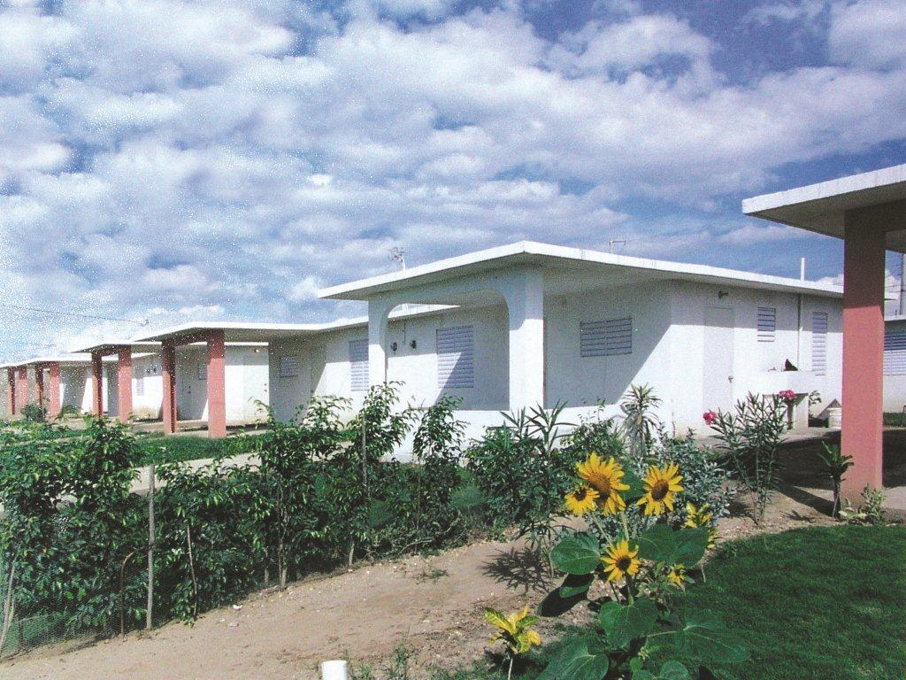
West Cumberland
St. Catherine
“Pleasures and palaces though we may roam,
Be it ever so humble, there's no place like home” -John Howard Payne

Slide 28
JMB Facilitating Home Ownership in the
21st Century

Slide 29
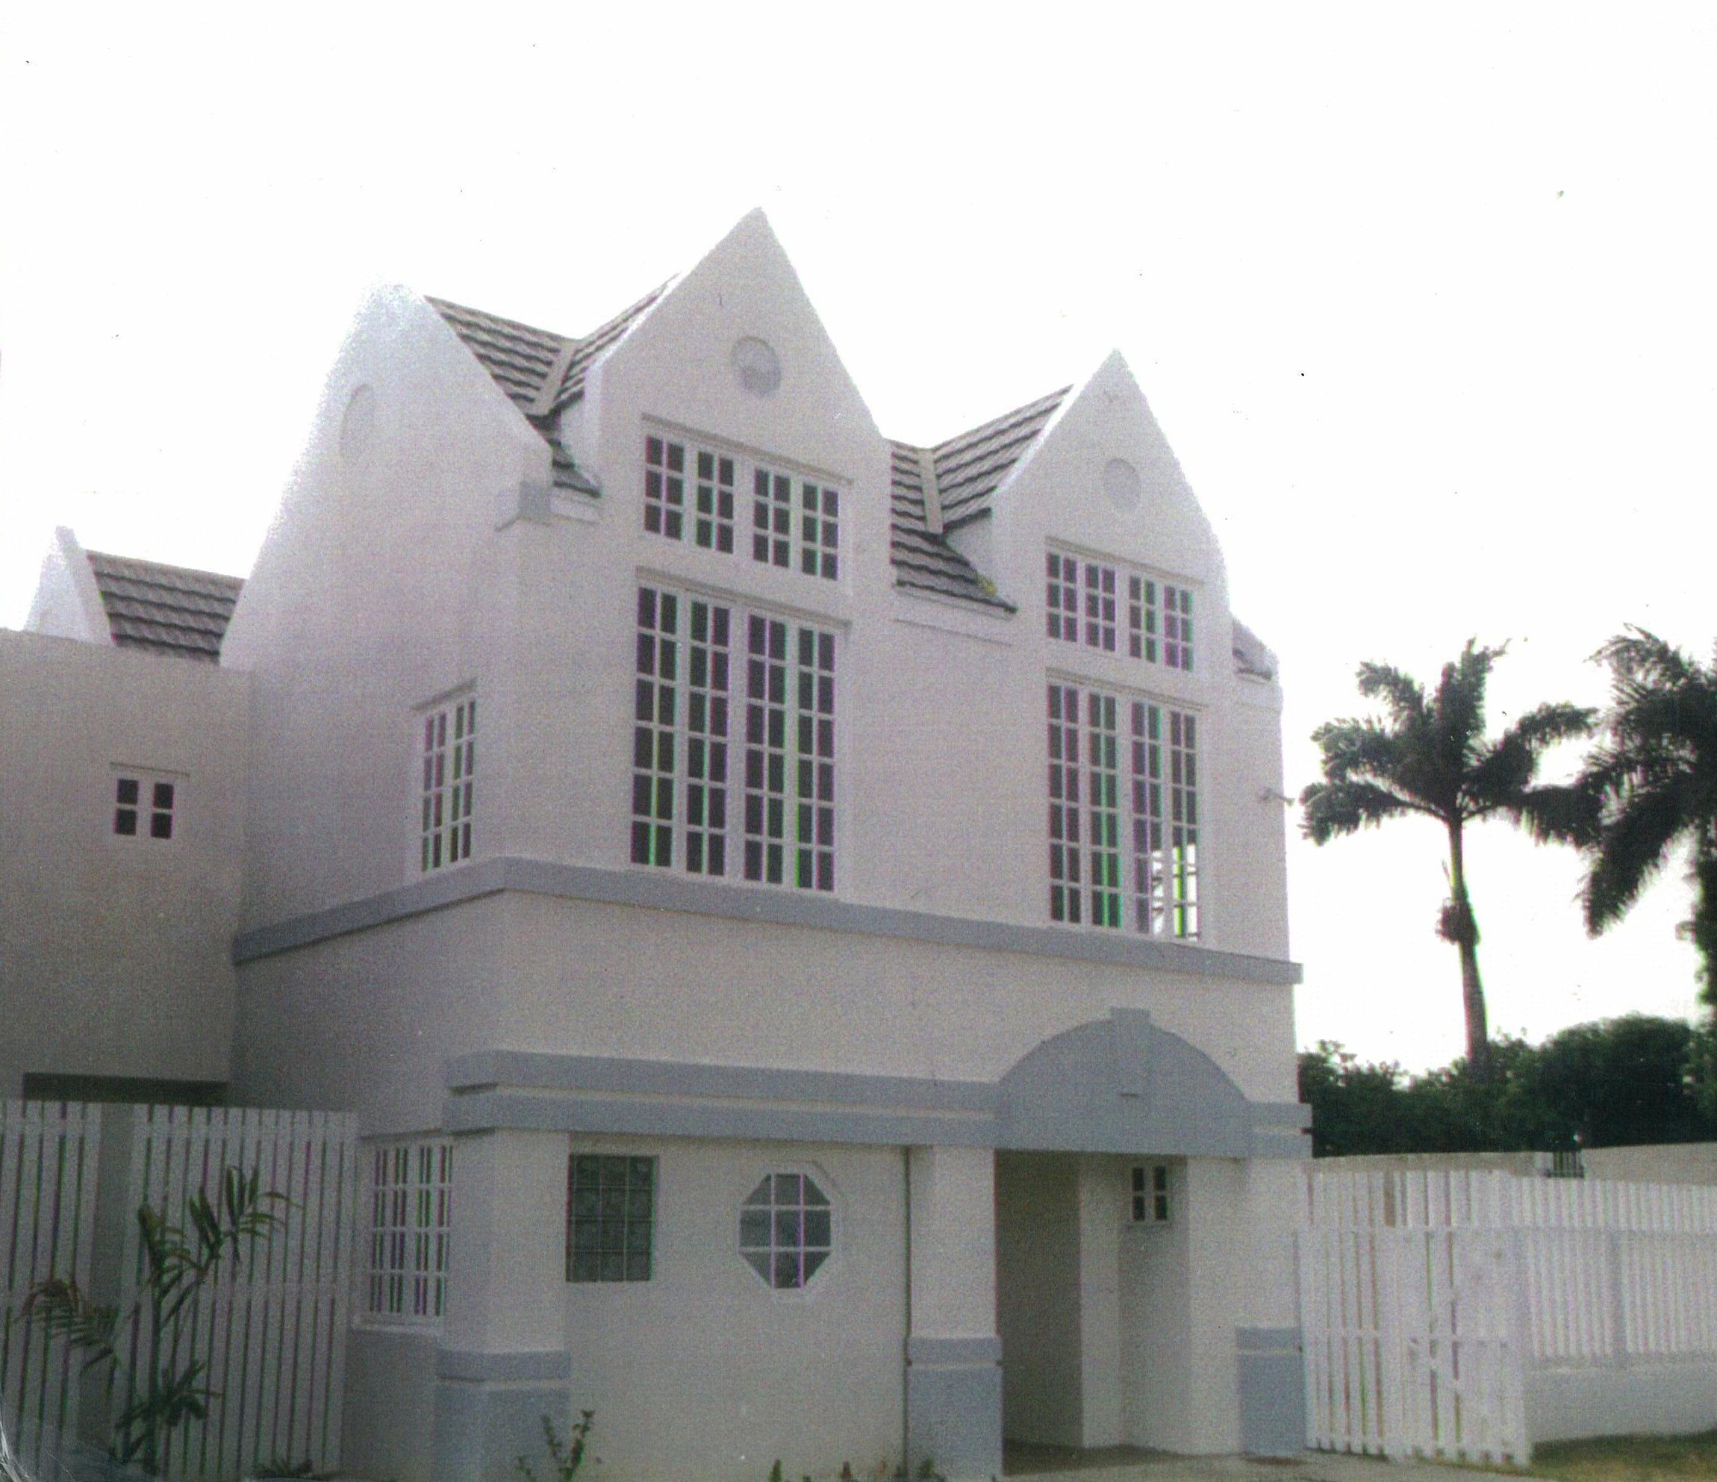

Dewsbury
St. Andrew
“Home is the womb that holds the soul”
Aisha Patterson

Slide 30
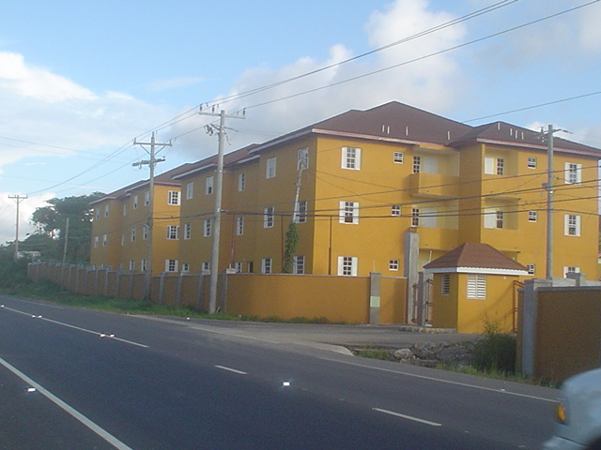
Emerald Apartments
St. Mary
“Home is the place where your heart will stay”
Aisha Patterson

Slide 31
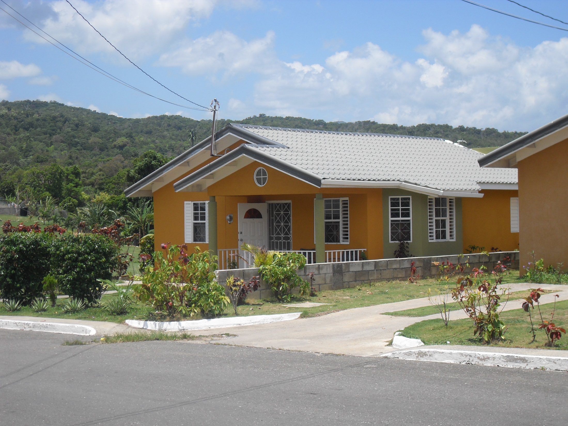
Greenwich Estate
St. Ann
“No more from that cottage again will I roam;
Be it ever so humble, there's no place like home.” - John Howard Payne

Slide 32
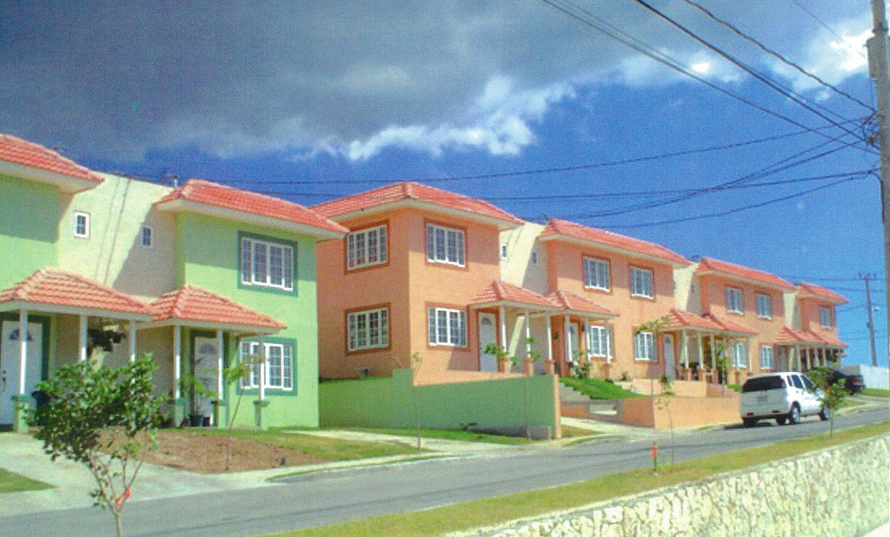
St. Andrew
Long Mountain Country Club
“Home is the place your heart resides”
-Aisha Patterson

Slide 33
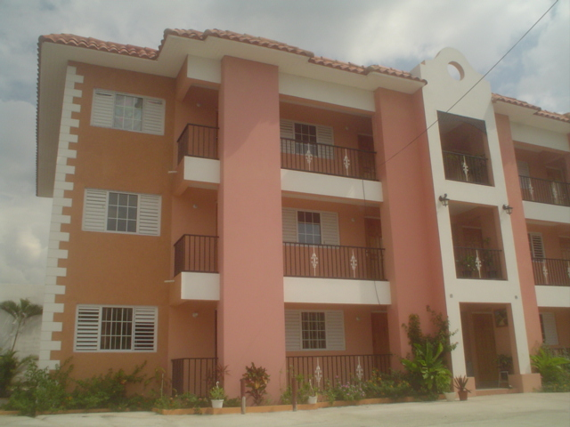
Mannings Manor
St. Andrew
“Pleasures and palaces though we may roam,
Be it ever so humble, there's no place like home” -John Howard Payne

Slide 34
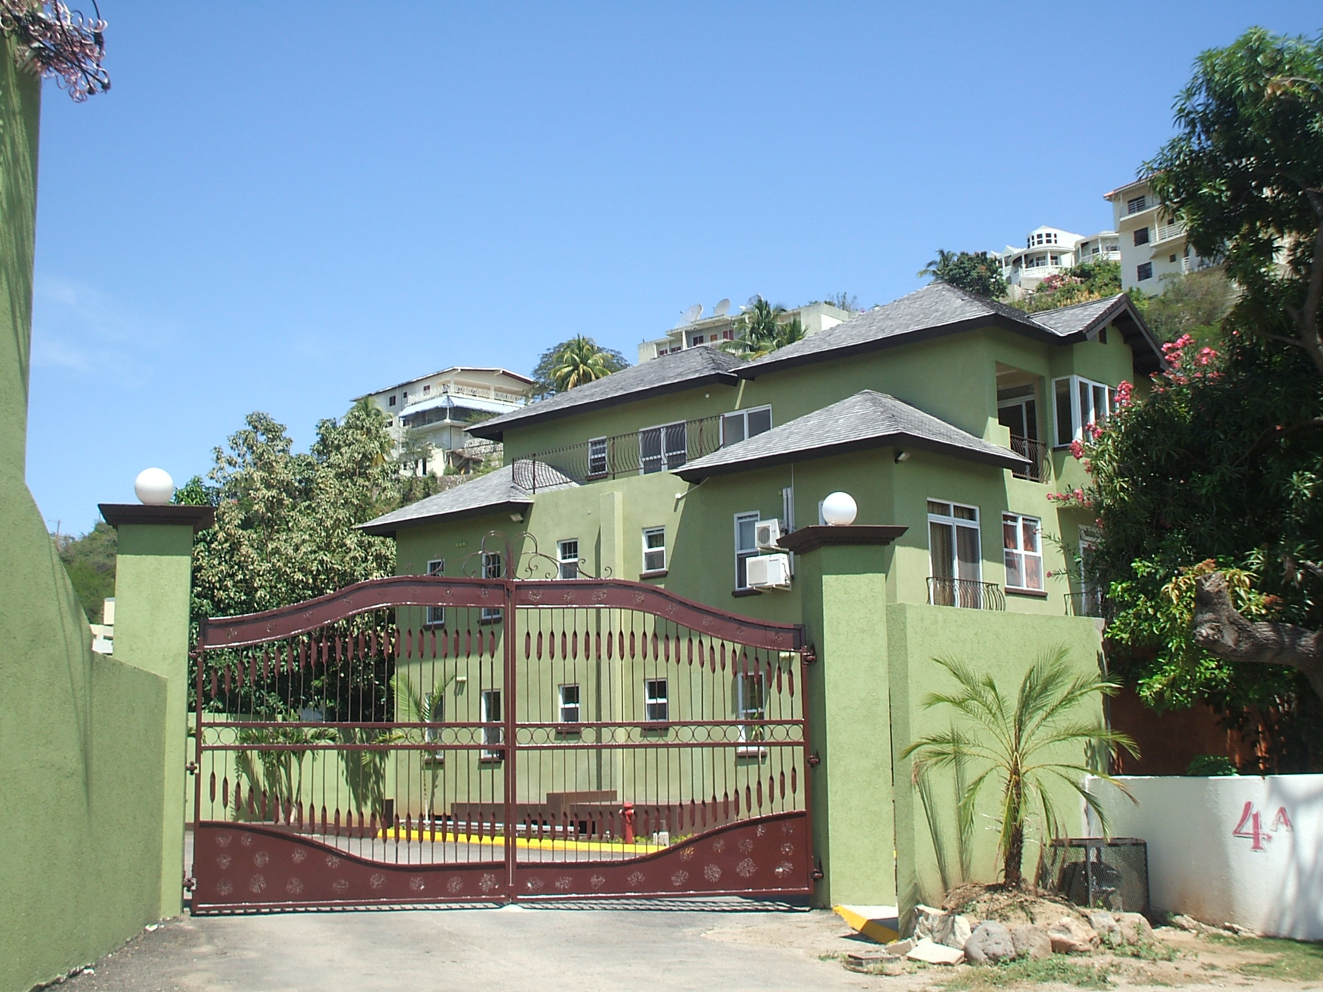
Monte Cristo
St. Andrew
“Home is the womb that holds the soul”
Aisha Patterson

Slide 35
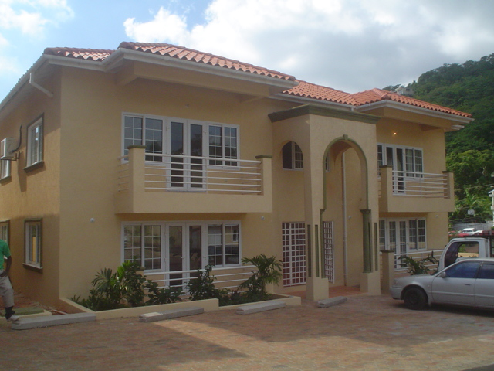
Pleasant Valley
St. Andrew
“Home is the place where your heart will stay”
Aisha Patterson

Slide 36
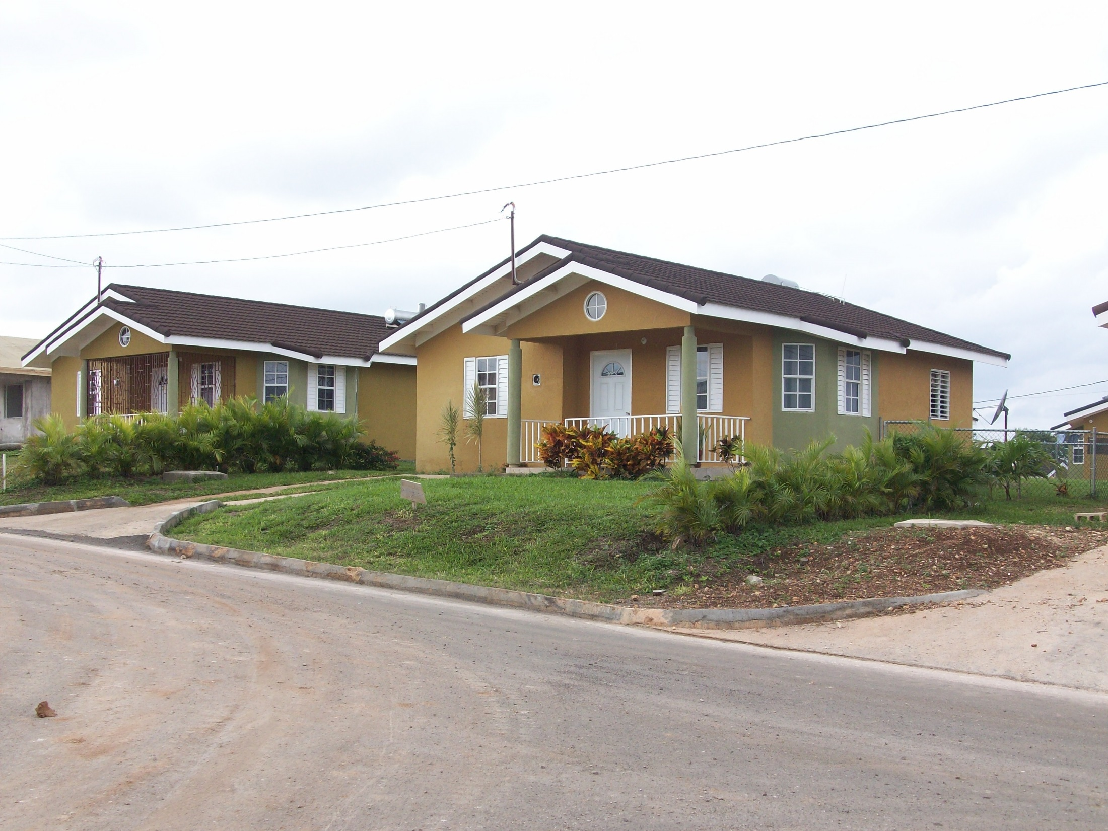
Stone Brook
Trelawny
“Home is the place your heart resides”
-Aisha Patterson

Slide 37
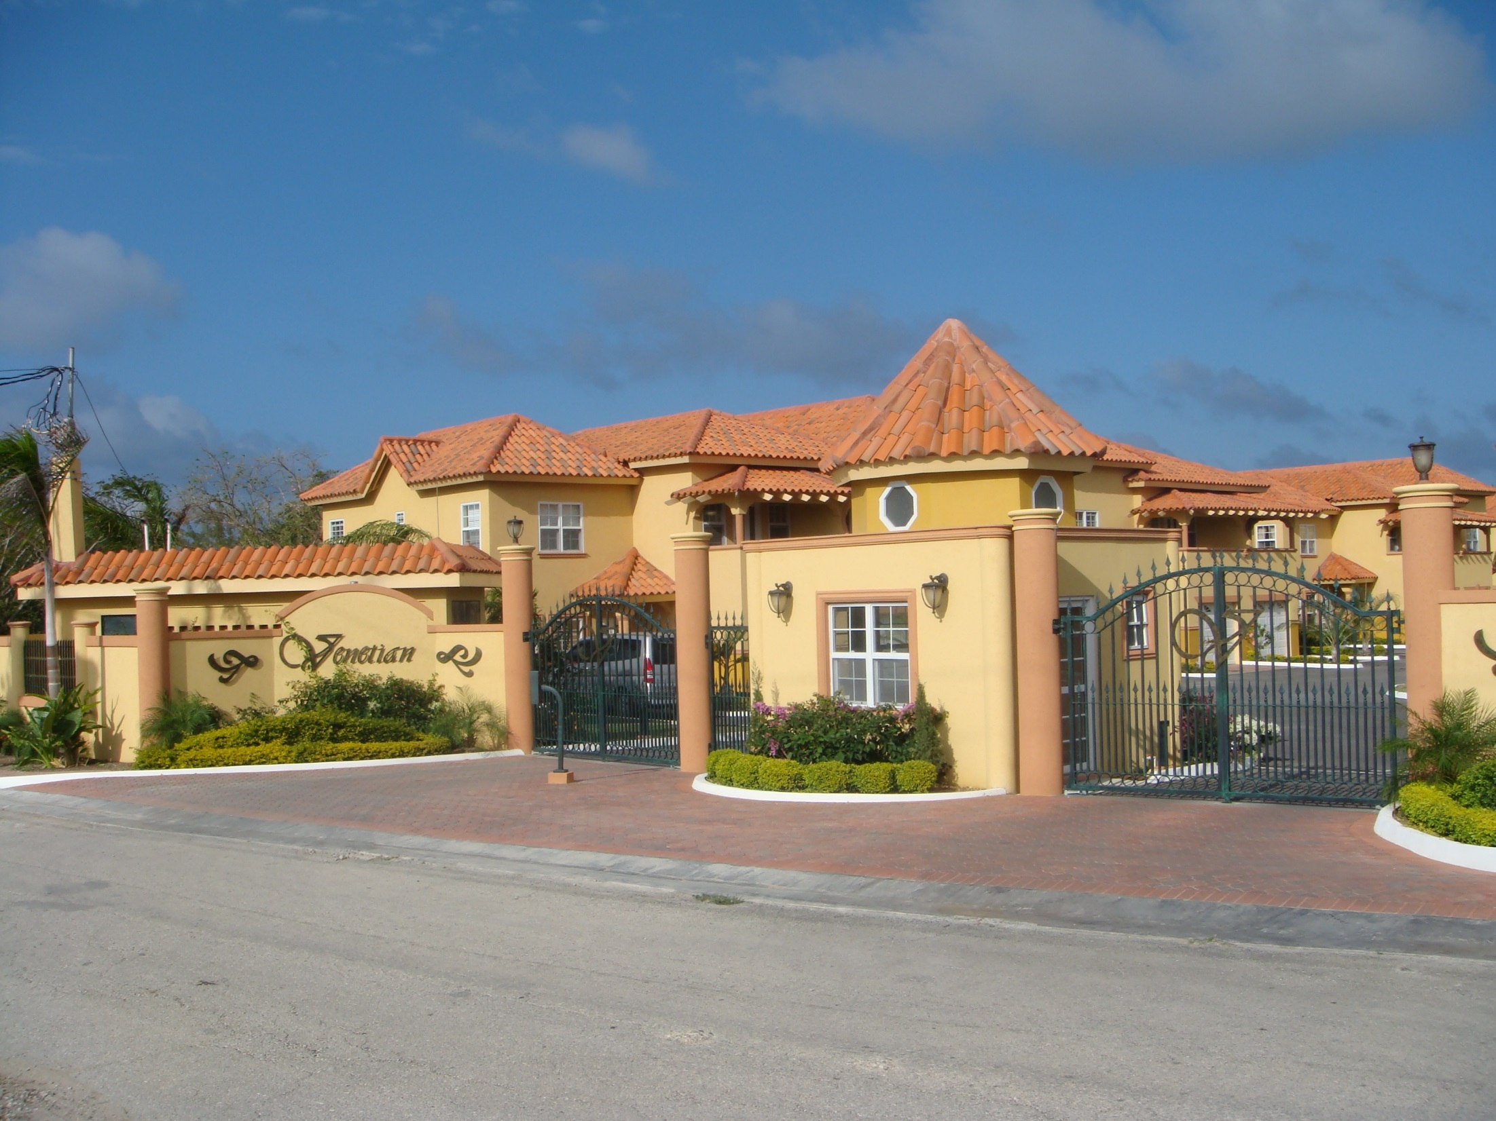
The Venetian
St. James
In the heart of Jamaica’s second city, this beautiful residential complex was built.

Slide 38
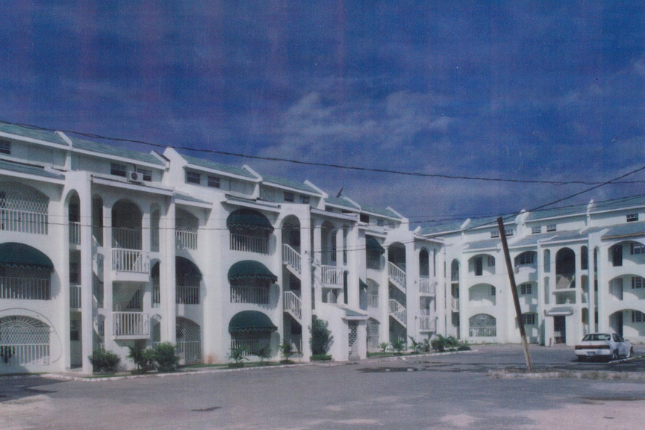
La Ventura
St. Andrew
Providing a window of opportunity for Jamaicans to own a home

Slide 39
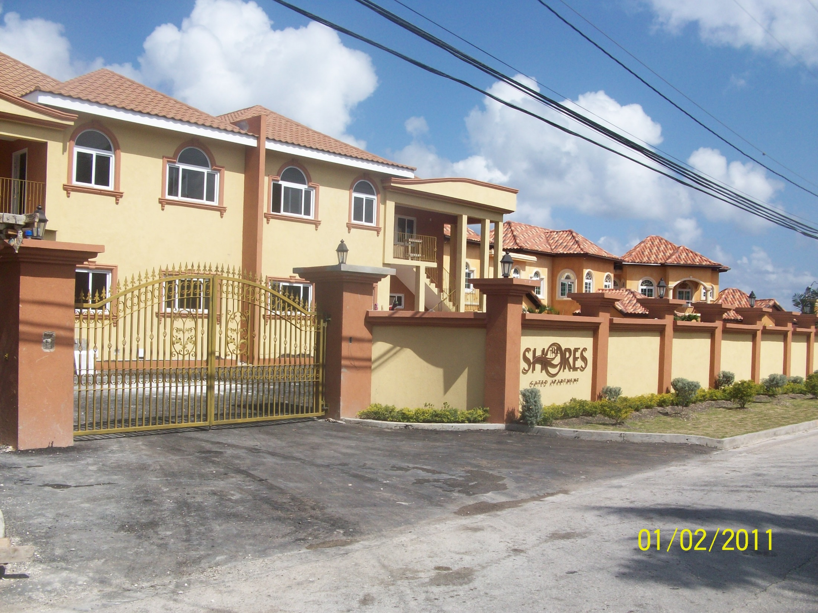
The Shores
St. James
“Pleasures and palaces though we may roam,
Be it ever so humble, there's no place like home” -John Howard Payne

Slide 40
JMB Facilitating Home Ownership in the
21st Century and Beyond

Slide 41
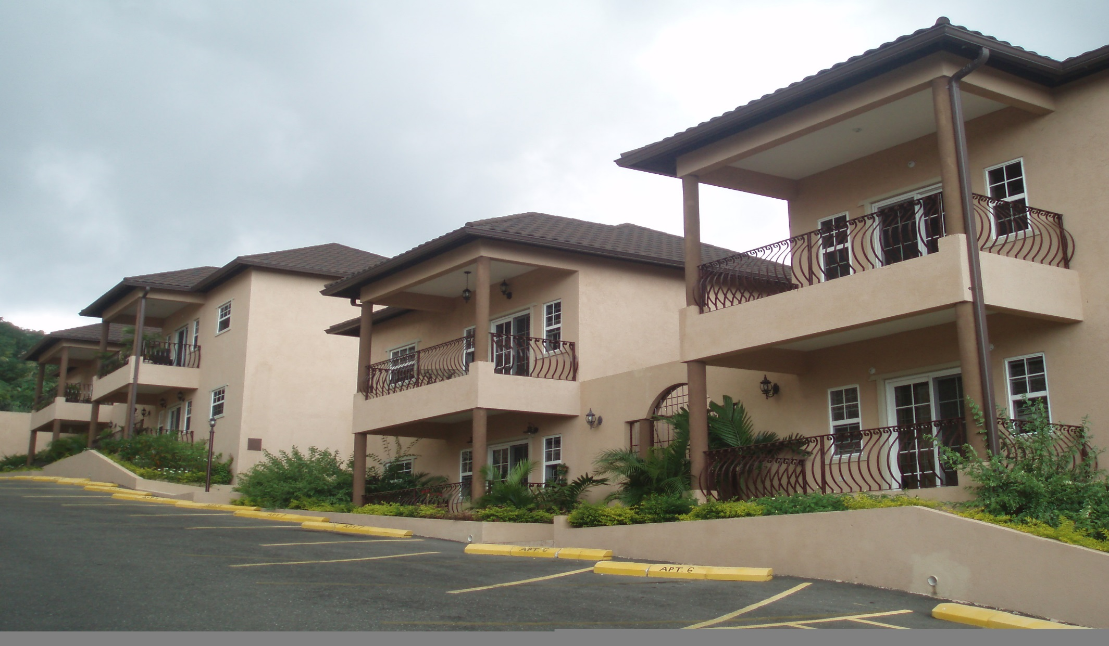
Hillview
St. Andrew

Slide 42
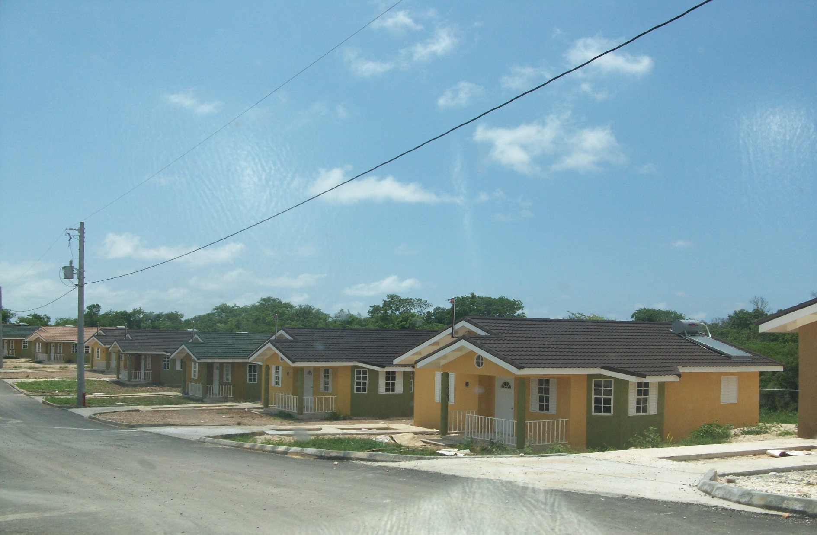
Stonebrook
Trelawny

Slide 43
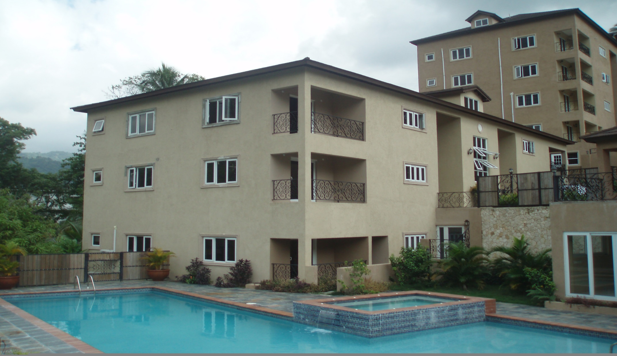
The Riveria
St. Andrew

Slide 44
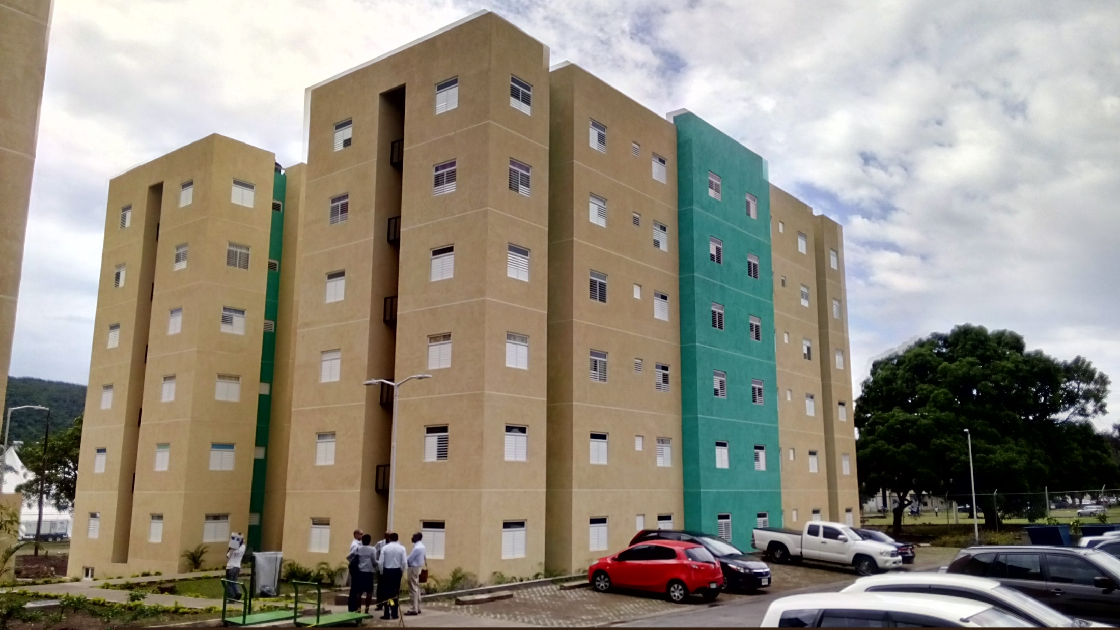
UWI State of the Art Dorms

Slide 45
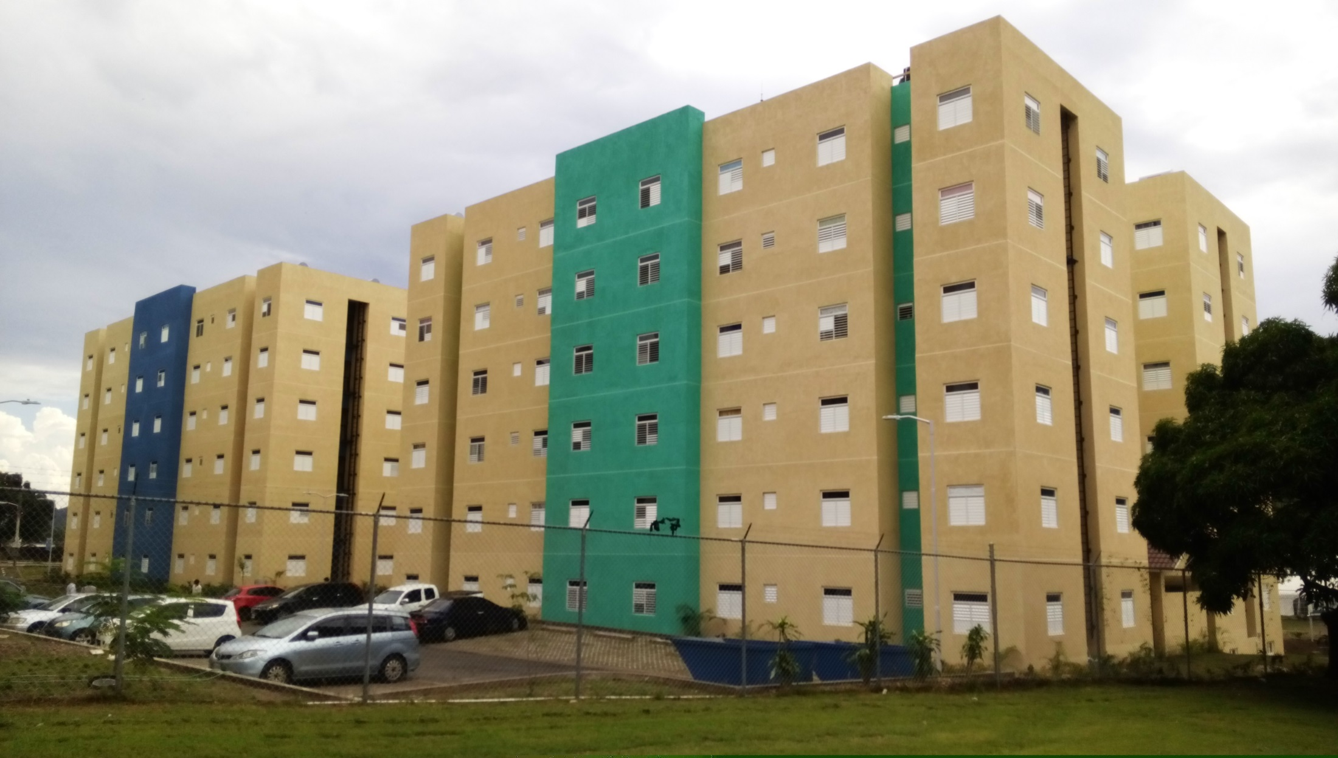
UWI State of the Art Dorms

Slide 46
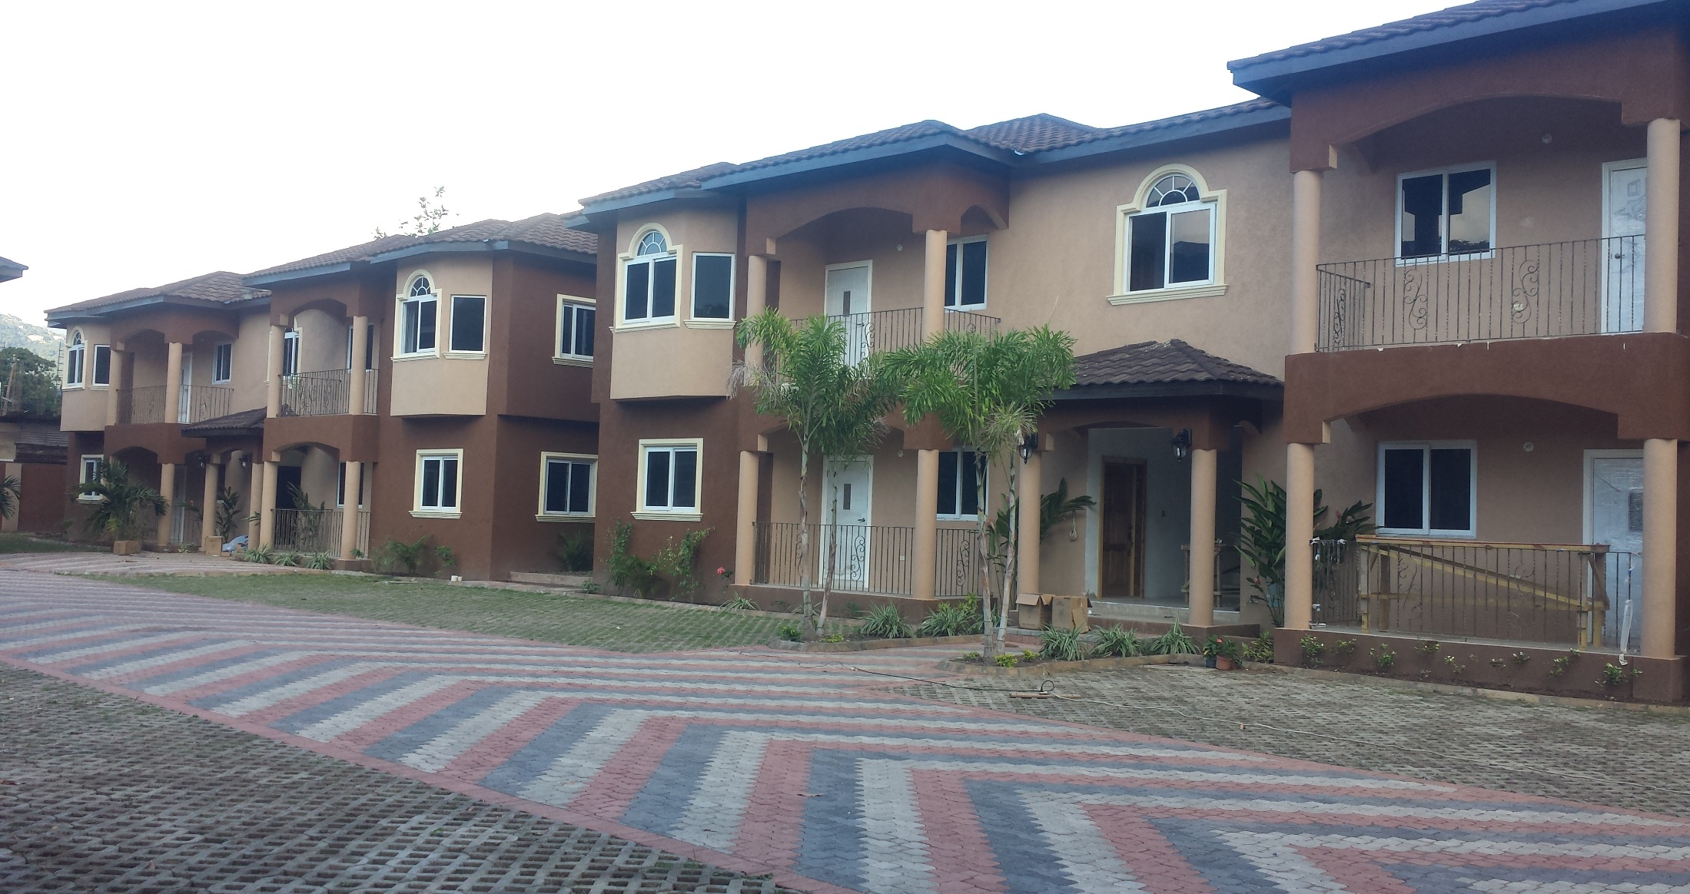

Knightsdale
St. Andrew
Knightsdale
St. Andrew

Slide 47
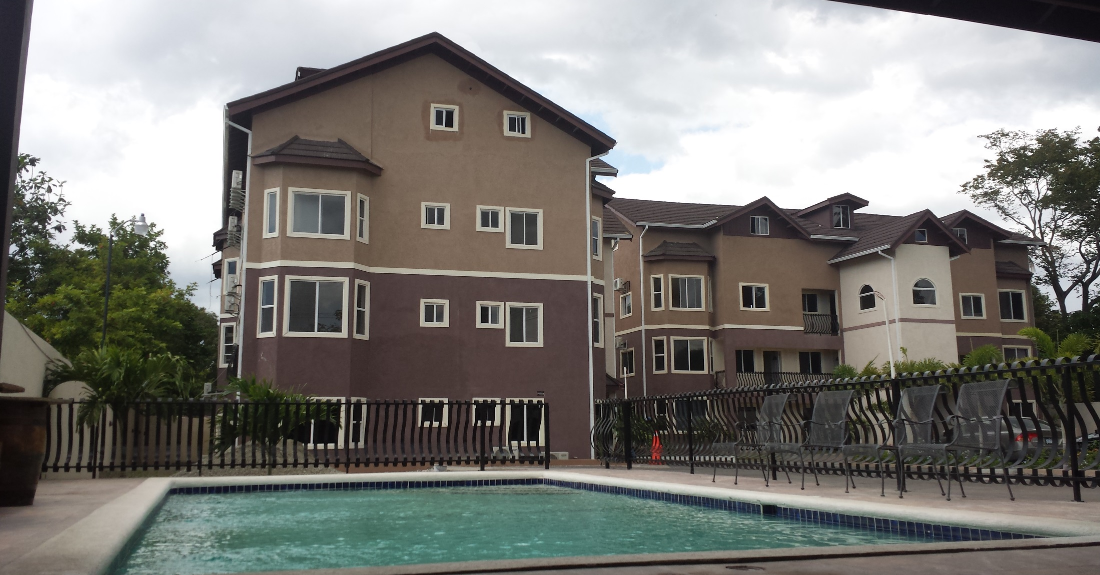
Abu Dhabi
St. Andrew

Slide 48
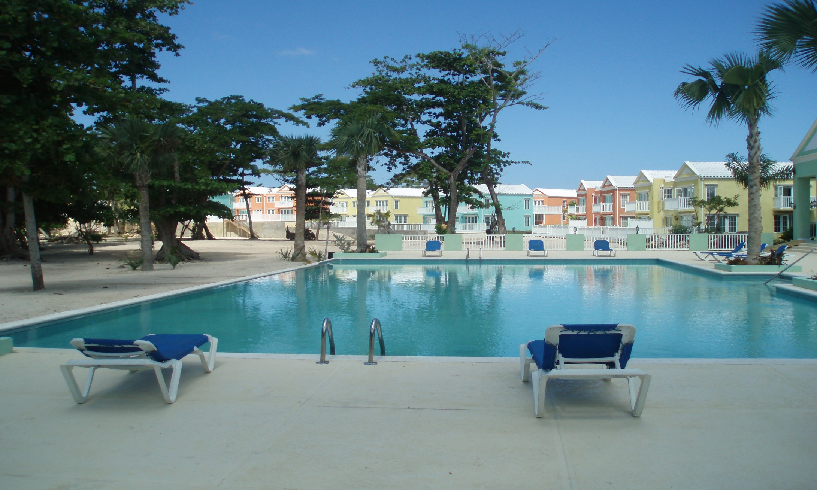
Little Bay Country Club
Negril, Westmoreland

Slide 49
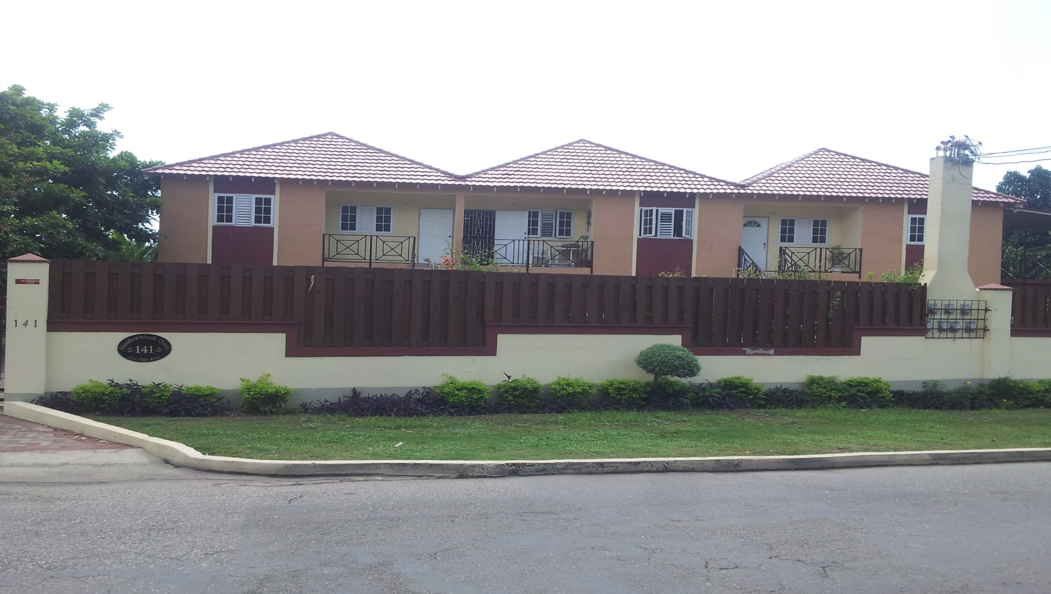
Meadowbridge
Meadowbridge Estate
St. Andrew
St. Andrew

Slide 50
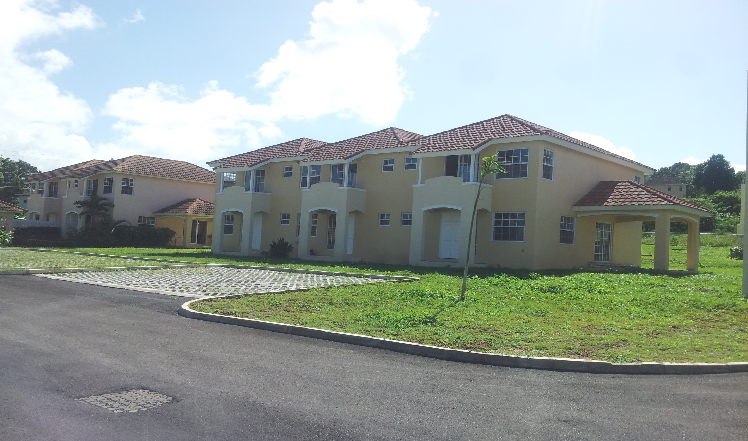
Huddersfield
Huddersfield
St. Mary
St. Mary

Slide 51
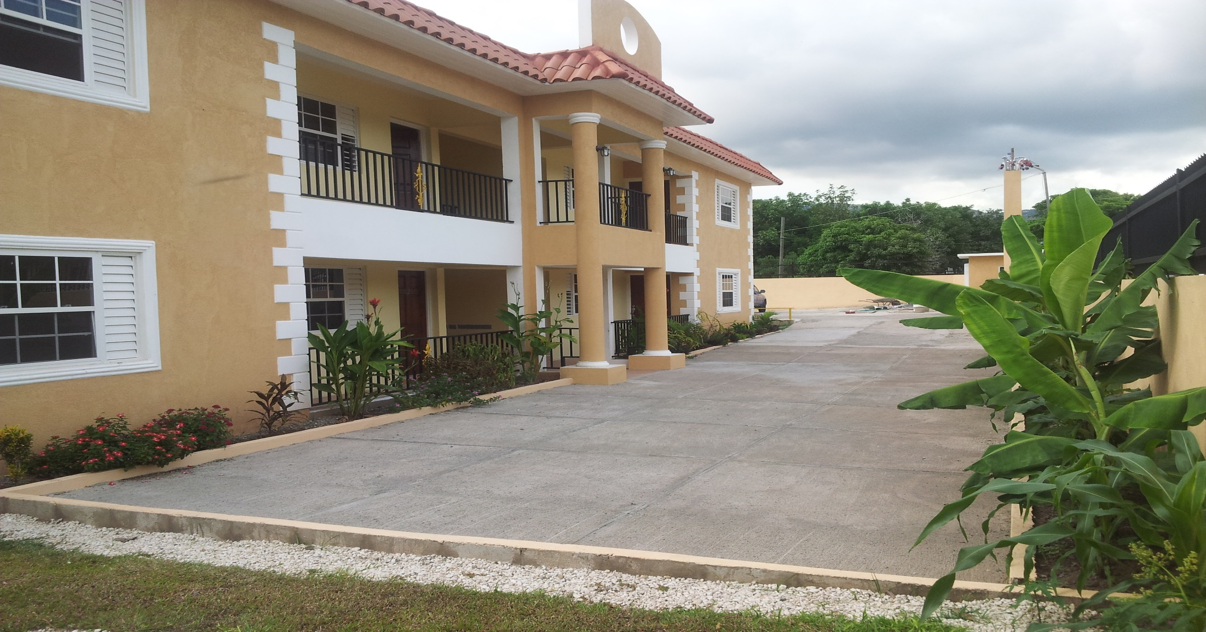
The Colleges
The Colleges
St. Andrew
St. Andrew

Slide 52
Thanks to all who have helped us
help Jamaicans
achieve home ownership!

Slide 53

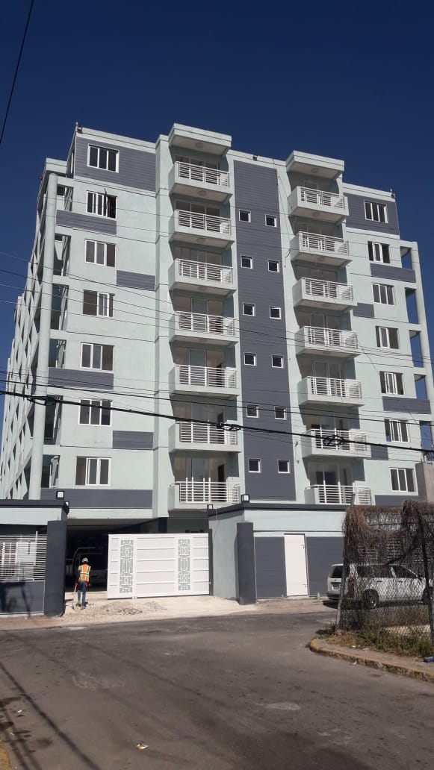
JMB’s PERFORMANCE DATA (5 YEARS)
Kensington Gates, St. Andrew
# of Projects Assessed Island-Wide: 58
Project Cost Value: Approx. $26B
JMB will set a record in terms of project value written in the 2020/2021 COVID year. Exceeding our record set in the 2018/2019 fiscal year.
Increased number of female developers

Slide 54
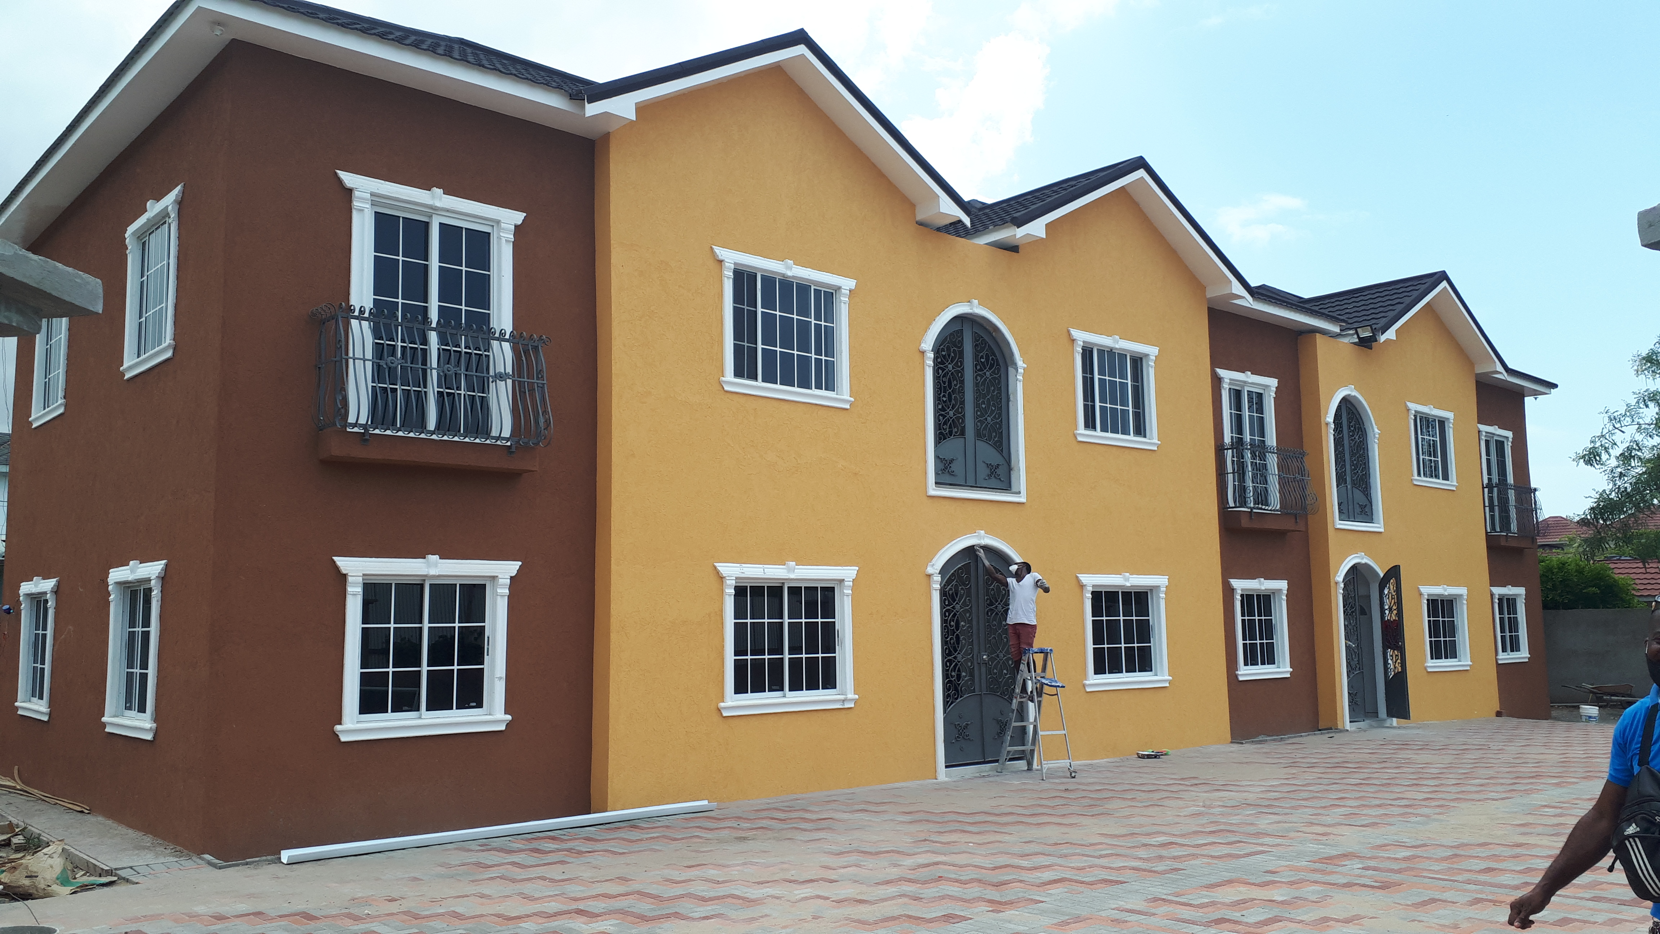
JMB PERFORMANCE DATA (5 YEARS)
Average Sqft. size of an apt. unit moved from 1,334 to 937

Slide 55
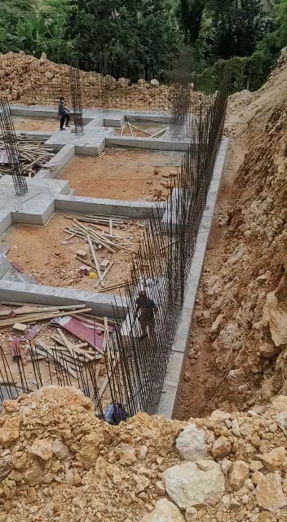
JMB PERFORMANCE DATA (5 YEARS)
Palais de la Richesse
Avg. Cost of Construction moved from Approx. $8,400 per sqft. to a high of $15,200 per sqft.
JMB Restricted, Board Retreat-18-11-2020

Slide 56
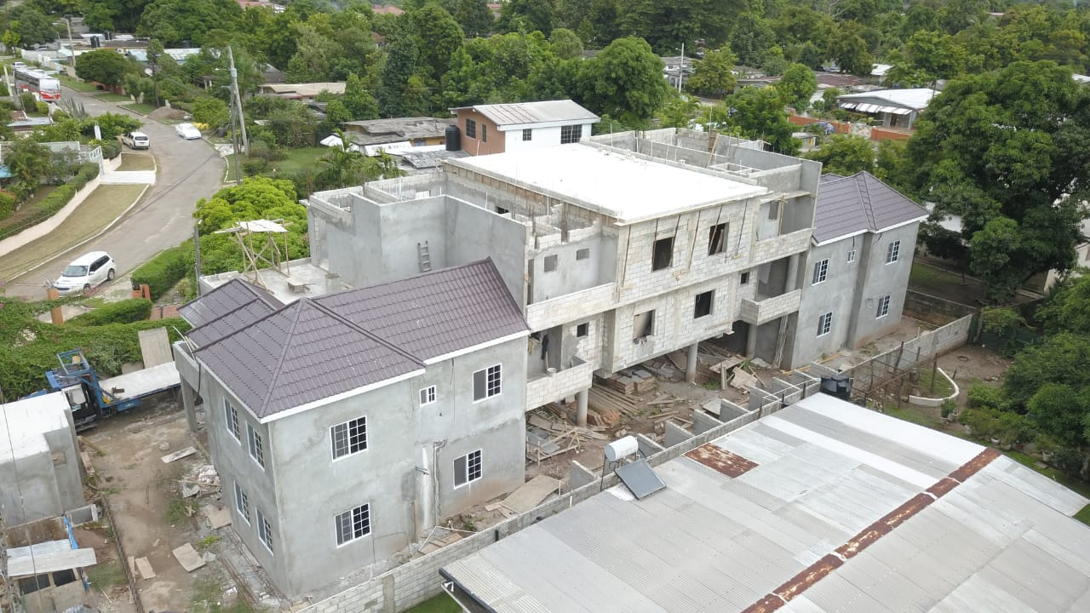
JMB PERFORMANCE DATA (5 YEARS)
Portview Manor
Avg. Price per unit remained flat primarily due to the reduction in size.
However, Avg. Price per sqft. moved from approx. $18,700 to $26,700

Slide 57

JMB PERFORMANCE DATA (5 YEARS)
Portview Manor
Avg. ROI on projects funded by the JMB is 21% with ROE exceeding 80%
Only the Stock Market can compete with this level of consistent returns.

Slide 58
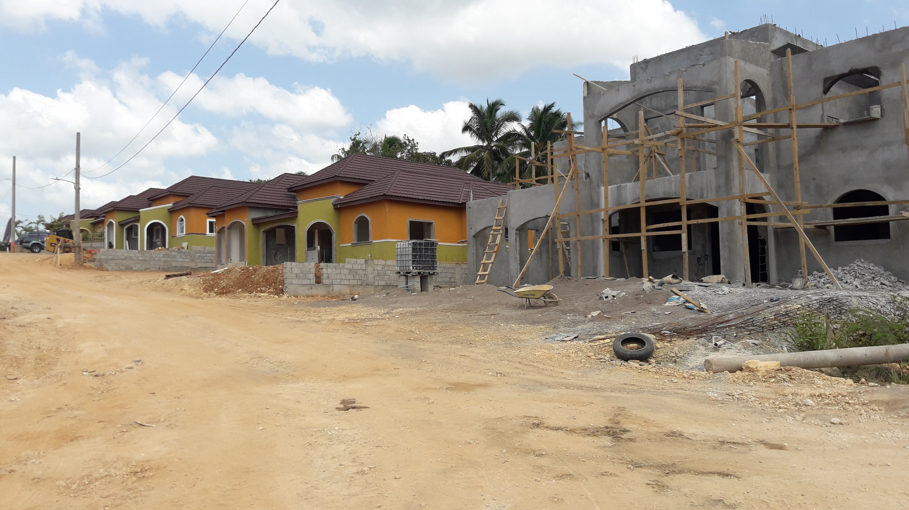
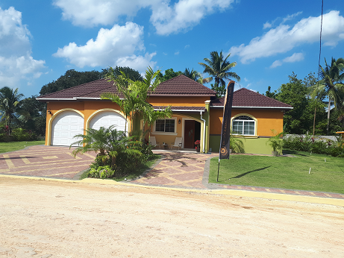
OPTIONS FOR CONSTRUCTION FINANCING
Kings Landing, Linstead
The JMB have noted the GoJ’s goal of providing 70,000 housing solutions in 4 to 5 Years.
Price point set by the PM is within the low income range of $8M per unit.

Slide 59
OPTIONS FOR CONSTRUCTION FINANCING
Kings Landing, Linstead
NHT maximum loan to a couple is approximately $13M.
There is significant demand for low to low middle income housing. ($5M to $8M) per unit.

Slide 60
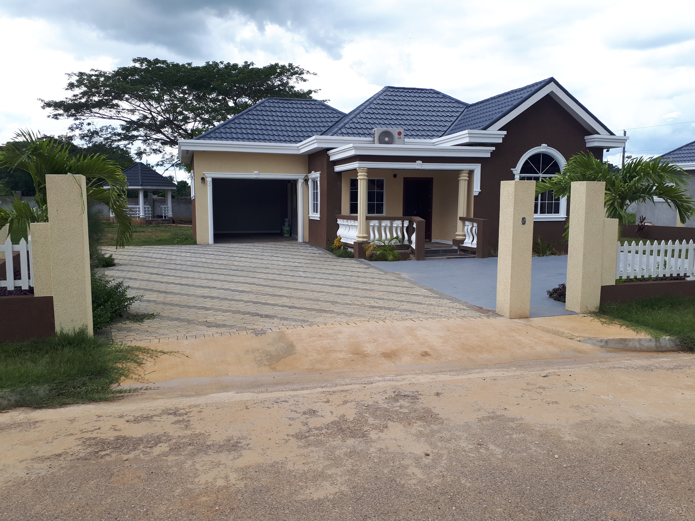
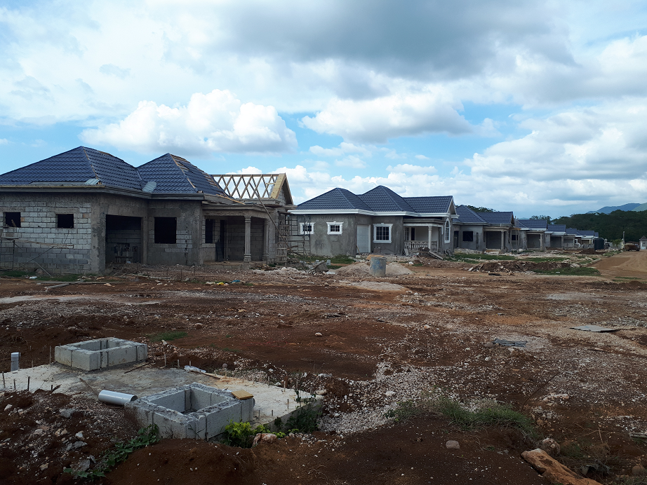
OPTIONS FOR CONSTRUCTION FINANCING
Genesis Manor, St. Elizabeth
Assume a mix of solutions:
25% service lots
75% units
Assume a private Developers will need to retain 20% to 21% ROI in any arrangements w/GOJ

Slide 61

OPTIONS FOR CONSTRUCTION FINANCING
All-in cost would be approx. $5.5M X 70K solutions.
Cost to meet the GOJ’s goal (supply side) is estimated at between $350B to $380B (excluding land)

Slide 62



OPTIONS FOR CONSTRUCTION FINANCING
THE OPPORTUNITY FOR ECONOMIC GROWTH IS IN THE SUPPLY-SIDE OF HOUSING
Financial
Intermediaries
Supply
FUNDING
PROVIDERS
MORTGAGE
PROVIDERS

Slide 63
OPTIONS FOR FUNDING THE SUPPLY SIDE ?
NHT
  Provide a sizeable chunk of the $350B to $380B
    Housing construction spend estimated at $12B annually ($48B in 4 to 5 years)
Private Developers from own resources estimated ($30B)
Other Government Entities ($12B)
Pension Funds (Explore Chilean Model)
  Funds under management (2016 report) was approx. $396B

Slide 64
OPTIONS FOR FUNDING THE SUPPLY SIDE ?
OTHER OPTIONS TO FILL ANY GAP:
Selling off or Factoring a Portion of Mortgage Receivables Currently on our Books
  The Big Five has approximately $400B of Mortgage Loan Receivables in a fairly liquid market
Create an RMBS Market (deepening of the securities market)
  Package quality loans as security for investment vehicle purposes
FIs need to take more calculated risk-reallocation of assets
  The Big Three still hold some safe GOJ paper or CDs
Public Private Partnerships (PPP)

Slide 65

HOUSING DEVELOPMENT IN JAMAICA IS A HUGE OPPORTUNITY FOR A DIASPORA INVESTOR
Indirect Investor
Real Estate Investment Trust (Funds)
  Primarily used to Facilitate the Rental Market
Create and Offer Diaspora Bonds or Participate in Open Market Securities Such as RMBS

Slide 66
OPTIONS FOR CONSTRUCTION FINANCING
WIN/WIN FOR GOVERNMENT-LOTS OF TAXES
  Stamp Duty on Bonds
  Stamp duty on Loan agreements
  Contractor Levy
  GCT on Construction Material
  Stamp duty on Mortgages
WIN/WIN FOR GOVERNMENT-LOTS OF TAXES
  Registration of Mortgage
  Transfer taxes on Sale
  Stamp duty on Transfer
  Increased Property Tax with the developed land

Slide 67
INDIRECT SPIN OFF INTO THE FORMAL AND INFORMAL ECONOMY SPURING FURTHER GROWTH
Multiplier Effect at about 3X
Hardware Stores
  Create additional employment and taxes
MOM and POP Stores
Vending
Aggregators

Slide 68
JAMAICA HAS ALL THE SKILLS OR TRAINING INSTITUTIONS NEEDED TO BUILD HOUSES
Skilled Laborer
Unskilled Laborers
Professionals
  Engineers
  Architects
  Quantity Surveyors
  Contractors
  Lawyers
  Bankers
Absolutely no need to import any skill to build houses Jamaica

Slide 69
CONCLUDING
Long been recognized that there is a significant shortfall in demand for housing
The real opportunity for economic development and job creation is on the supply-side of housing for purchase or rental
If we are serious about housing as a driver for economic growth, we could build out thousands of homes each year
There are innovative ways to fund housing development
  Private investors
  Financial Institutions
  Government

Slide 70
Sources
NHT-Annual Report 2018/2019
Bank of Nova Scotia (BNS)-Annual report 2019
NCBFS Group-Annual Report 2020
FSC-Annual Report 2015/2016
VMBS-Annual Report 2019
JN Group-Annual Report 2020
JMB Internal data
Song and lyrics-”My Dream” by Greg Nesbeth

Slide 71
THANKS
Q & A

